Slide 1

Selective Cookie Outsourcing using Private Information Retrieval
Students: Apoorva Karnwal (22BCE0756),
Shivesh Kaushik (22BCE2232)
Guide: Prof. Kathiravan Srinivasan, Professor Grade 1
School: SCOPE, VIT
Programme: B.Tech. in Computer Science & Engineering
Date: September 2025

Slide 2
Aim
To develop a hybrid privacy framework that integrates Machine Learning (ML)–based cookie classification with Private Information Retrieval like for system.
Current compliance mechanisms (cookie banners, CMPs) provide legal consent management but fail to ensure strong privacy protection.
Collect and preprocess cookies with relevant attributes and metadata.
Train ML models (XGBoost, LightGBM, CatBoost) to classify cookies into categories — Essential, Functional, Analytics, Marketing.
Apply strict consent management for browser and only allowing minimum required cookies to be stored in browser.
The framework ensures a scalable, deployable solution that balances privacy, usability, and performance.

Slide 3
Motivation
There is rising demand for privacy-aware browsers and compliance tools.
Public awareness and legal pressure (GDPR, CCPA) demand technical enforcement, not just policy.
Cookies are vital for web personalization and authentication but are often misused for tracking and profiling.
Cookie banners and CMPs ensure legal compliance but fail to protect privacy technically.
Completely blocking cookies is impractical as it breaks website functionality.
ML classification provides an intelligent way to separate sensitive cookies.
This project bridges the gap between legal consent and technical privacy control.

Slide 4
Literature Review
Berens et al. (2024): Found that 70% of websites still store non-essential cookies even after user rejection. Shows that consent banners manipulate users into clicking “Accept All.”
Bouhoula et al. (2023): Built crawlers for 97,000+ sites to analyze cookie banners and compliance. Found widespread non-compliance and hidden reject options on most websites.
Hu et al., (2021): Used ML-based lexical features to classify cookies efficiently. Proved feasibility of using machine learning for cookie categorization.
Munir et al., (2023): Exposed trend of first-party tracking replacing third-party tracking. Introduced graph-based detection using behavioral and network features.
Vithana et al., (2023): Surveyed PIR variants — single-server (CPIR) and multi-server (ITPIR). Identified trade-offs in communication cost and practicality.

Slide 5
Research Gaps
Most Consent Management Platforms (CMPs) and cookie banners are compliance-oriented, not privacy-enforcing.
Existing solutions depend on user consent rather than automated control. No mechanism ensures that rejected cookies are actually blocked or removed.
ML models (e.g., CookieMonster, CookieGraph) classify cookies accurately based but do not provide any privacy protection after identification.
Private Information Retrieval (PIR) offers strong theoretical privacy, but hasn’t been applied to real-world browser environment.
Research lacks deployable, low-latency frameworks that can operate inside browsers at scale.

Slide 6
Problem Formulation
How to classify cookies automatically and protect only sensitive ones efficiently.
How to ensure privacy preservation without affecting website performance or UX.
How to achieve low latency, scalability, and transparency simultaneously.
Problem lies in balancing privacy enforcement with functional necessity.
Traditional methods either sacrifice performance or privacy.

Slide 7
Proposed System
Browser Extension (Client): Captures cookies and extracts features (Secure, HttpOnly, SameSite).
ML Classifier: Classifies cookies as Essential, Functional, Analytics, Marketing.
Policy Engine: Determines which cookies to outsource securely.
PIR Server: Encrypts and processes sensitive cookies.
Designed modularly for integration with Chrome Browser.
Uses ONNX export for lightweight browser-based inference.
Architecture balances client-side speed with server-side privacy.

Slide 8
End-to-End Working of the Cookie Privacy Framework
Data Collection: The Chrome extension captures cookies in real time, collecting attributes like HttpOnly, Secure, SameSite, Expiry, and Domain.
Feature Extraction & Preprocessing: Relevant cookie features are extracted and converted into numerical form for ML model compatibility.
ML-Based Classification: The LightGBM model classifies cookies as Essential, Functional, Analytics, or Marketing based on extracted features.
PIR Browser Extension: Sensitive cookies are encrypted and securely outsourced using a Private Information Retrieval (PIR) mechanism.
Cont…

Slide 9
End-to-End Working of the Cookie Privacy Framework
Dashboard & Visualization: All cookies and their classifications are displayed on a dashboard where users can view and manage privacy settings.
Result & Privacy Assurance: The system ensures accurate classification, secure encryption, and compliance with privacy standards in real time.

Slide 10
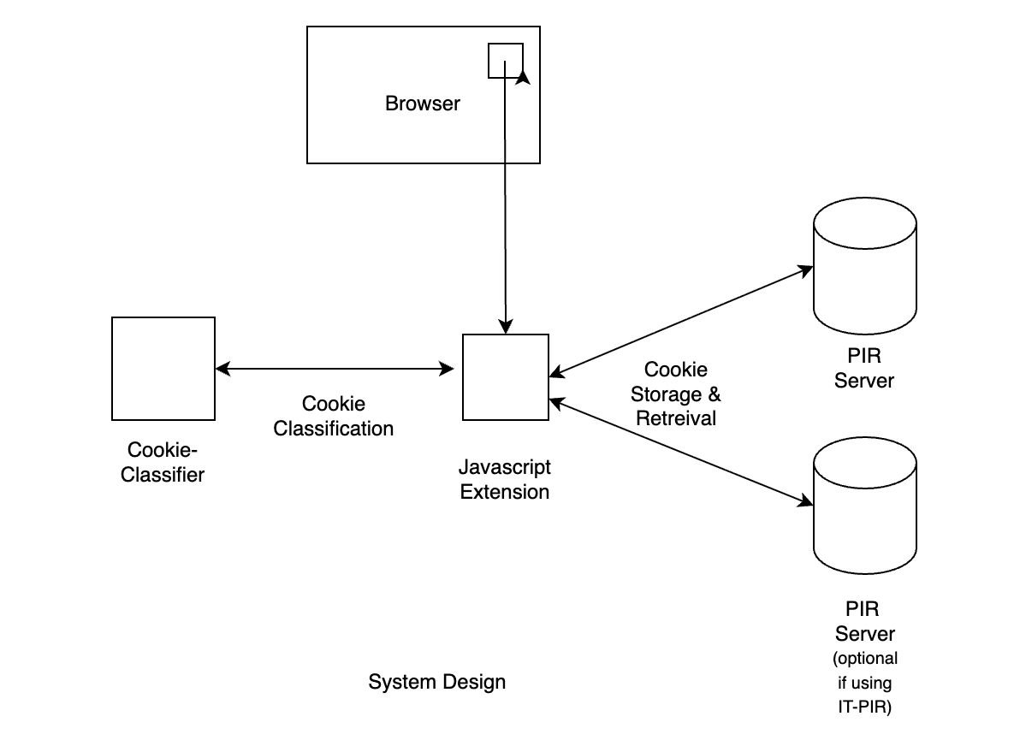
System Design
Figure showing Extension system design

Slide 11
Experimental Results
Dataset collection and Preprocessing :
Cookies were collected using OpenWPM, an automated web crawler, combined with Consent-O-Matic to detect and extract labels from active Consent Management Platforms (CMPs).
Each cookie entry included key attributes such as HttpOnly, Secure, SameSite, Domain, Path, and Expiry, along with contextual data like whether it was first-party or third-party.
The data underwent deduplication, normalization, and one-hot encoding to ensure consistent feature representation.
Boolean features were converted to binary values (True → 1, False → 0), while categorical ones like SameSite were encoded numerically.
Three supervised ensemble models — LightGBM, XGBoost, and CatBoost — were trained to classify cookies into four categories: Essential, Functional, Analytics, and Marketing.
The dataset was split into 70% training, 15% validation, and 15% testing

Slide 12
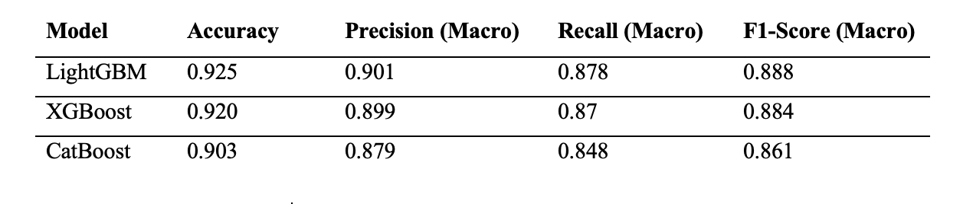
Experimental Results
Model Performance and Comparison:
Among all models, LightGBM achieved the best accuracy of 92.45%, outperforming XGBoost (92.0%) and CatBoost (90.3%).
LightGBM also recorded the highest F1-Score (0.888), indicating balanced performance across all cookie types.
The model effectively detected minority classes like Marketing and Analytics cookies with fewer false positives.

Slide 13
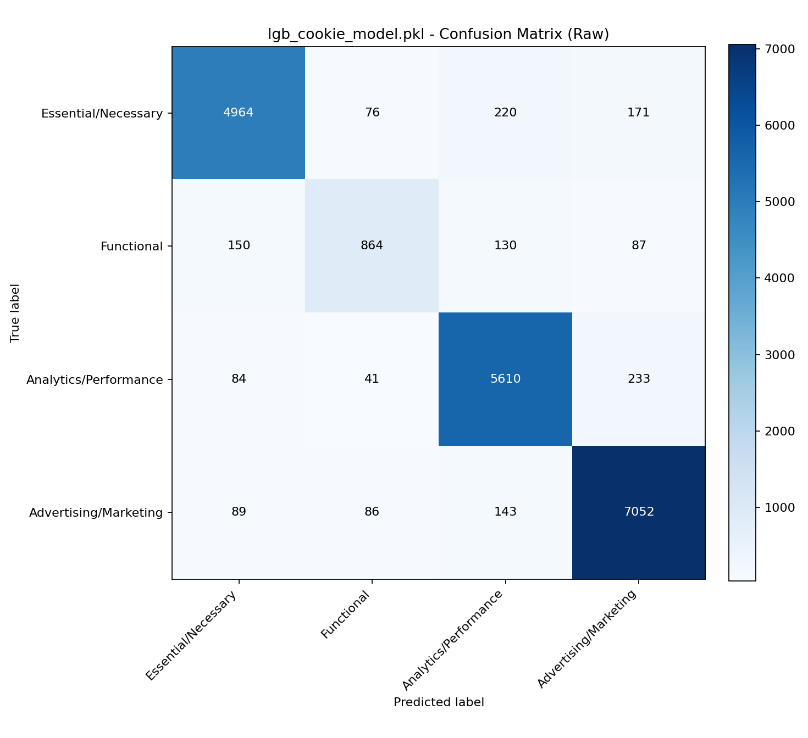
Experimental Results
Fig : Raw Confusion Matrix

Slide 14
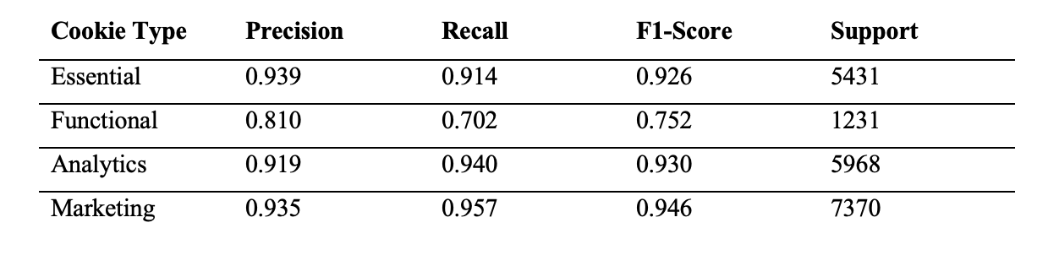
Experimental Results
Lightgbm Evaluation:
Essential cookies were detected with a precision above 93%, showing high reliability in recognizing authentication and session cookies.
Marketing cookies achieved a recall of over 94%, confirming robust detection of tracking and advertising-related cookies.
Analytics and functional cookies showed occasional overlap as they often share similar attribute patterns like Secure or SameSite flags
Overall, misclassifications remained below 10%.
Fig showing category-wise score for lightgbm

Slide 15
Experimental Results
PIR Like Encrpytion:
The browser extension receives a unique encryption key from the server, which is used to encrypt sensitive cookie data.
The server performs operations directly on encrypted data and returns an encrypted response to the client.
The extension then decrypts the response locally, ensuring that no sensitive information ever leaves the user’s control.
The server performs ‘all’ or ‘none’ retrieval of cookies stored in the db to ensure not leaking the particular cookie being retrieved by the extension.

Slide 16
Conclusion and Future Scope
Conclusion:
Proposed a hybrid ML + PIR solution for privacy-preserving cookie management.
LightGBM achieved high accuracy with low overhead.
Browser extension ensures transparency and real-time privacy.
Future Work:
Add behavioral and network-level features for better detection.
Explore multi-server PIR for stronger privacy guarantees.
Deploy as open-source plugin for public adoption.

Slide 17
Outcomes Achieved
Developed a fully functional browser extension that automatically detects, classifies, and manages cookies in real time using a trained ML model.
Achieved a classification accuracy of 92.45% with the LightGBM model, outperforming XGBoost and CatBoost across all key metrics.
Demonstrated end-to-end encryption between the browser extension and the PIR server, ensuring that cookie data remains confidential at all times.
Ensured full compliance with GDPR and CCPA principles by providing a technically enforced privacy framework instead of relying solely on user consent.
Validated the model’s scalability and deployability by containerizing the backend and exporting the classifier in ONNX format for lightweight browser-side inference.
Delivered a transparent and user-controllable privacy solution through a dashboard that allows real-time monitoring, cookie filtering, and secure handling

Slide 18
References
[1] Berens, B. M., Bohlender, M., Dietmann, H., Krisam, C., Kulyk, O., & Volkamer, M. (2024). Cookie disclaimers: Dark patterns and lack of transparency. Computers & Security, 135, 103507.
[2] Kosztyán, Z. T., Király, T., Csizmadia, T., Katona, A. I., & Vathy-Fogarassy, Á. (2025). Automated research methodology classification using machine learning. Engineering Applications of Artificial Intelligence, 132, 107007.
[3] Hu, X., Sastry, N., & Mondal, M. (2021). Corralling cookies into categories with CookieMonster. In Proceedings of the ACM Web Science Conference (WebSci ’21) (pp. 56–65). ACM.
[4] U., Englehardt, S., Shafi, Z., & Troncoso, C. (2023). Understanding and detecting first-party tracking cookies. ACM SIGSAC Conference on Computer & Communications Security.
[5] Bouhoula, A., Kubicek, K., Zac, A., Cotrini, C., & Basin, D. (2023). Automated large-scale analysis of cookie notice compliance. In 32nd USENIX Security Symposium (USENIX Security 23) (pp. 4069–4086). USENIX Association.
[6] Bollinger, D., Kubicek, K., Cotrini, C., & Basin, D. (2022, August). Automating cookie consent and GDPR violation detection. In 31st USENIX Security Symposium (USENIX Security 22).
[7] Sivan-Sevilla, I., Parham, P., & McGuigan, L. (2025). ‘Cookie-less’ identification for/against privacy? Internet Policy Review, 14(3).
[8] Luo, M., & Wang, M. (2025). Faster Spiral: Low-communication, high-rate private information retrieval. Cryptography, 9(1), 13

